Slide 1
SECURE DATA HIDING IN IMAGES USING STEGNOGRAPHY
CAPSTONE PROJECT
Presented By:
Student Name : Aditi Aswal
College Name & Department : Graphic Era deemed to be University, Computer Applications Department

Slide 2
OUTLINE
Problem Statement
Technology used
Wow factor
End users
Result
Conclusion
Git-hub Link
Future scope

Slide 3
Problem Statement
In an era of increasing digital communication where cyberattacks are very common, ensuring data confidentiality is a critical challenge. Traditional encryption methods make sensitive data detectable, raising the risk of interception. There is a need for a method that allows secure data transmission without attracting attention.
Steganography provides a solution by embedding secret messages within digital images, ensuring effective communication while maintaining the image's visual integrity.

Slide 4
Technology used
Python :The core programming language used to implement the steganography algorithm.
OpenCV :Used for image processing, reading, modifying, and saving images
OS Module :Used for file handling, such as opening the encrypted image automatically after encryption.
Visual Studio Code :An integrated development environment to run the code

Slide 5
Wow factors
Simple and interactive for easy encryption and decryption without complex setups.
Automatically opens the encrypted image for verification after processing.
The secret message is embedded in pixel values without significantly altering the image, making detection difficult.
This project requires a password to retrieve hidden messages, adding an extra layer of security.
Uses OpenCV for optimized image processing, ensuring quick encryption and decryption.

Slide 6
End users
Military, Defense & Secret Agencies: Used for communication between intelligence agencies and operatives in sensitive missions without raising suspicion.
Journalism: Allows journalists to share confidential data securely without being traced.
Secure Data Transmission: Protects sensitive corporate or government communications from cyber threats and unauthorized access.
Digital Watermarking & Copyright Protection: Embeds ownership or copyright details within media files to prevent piracy and unauthorized duplication.
Medical Data Security: Hides patient records in medical images to ensure privacy in healthcare communications.

Slide 7
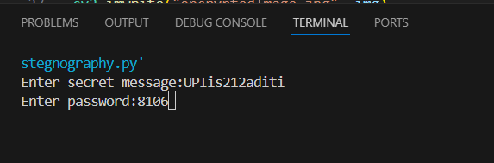

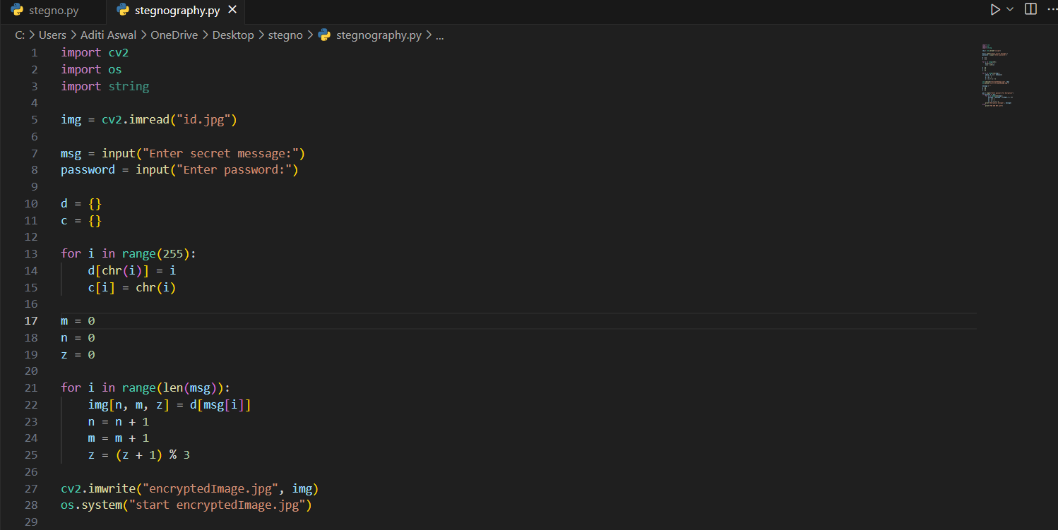
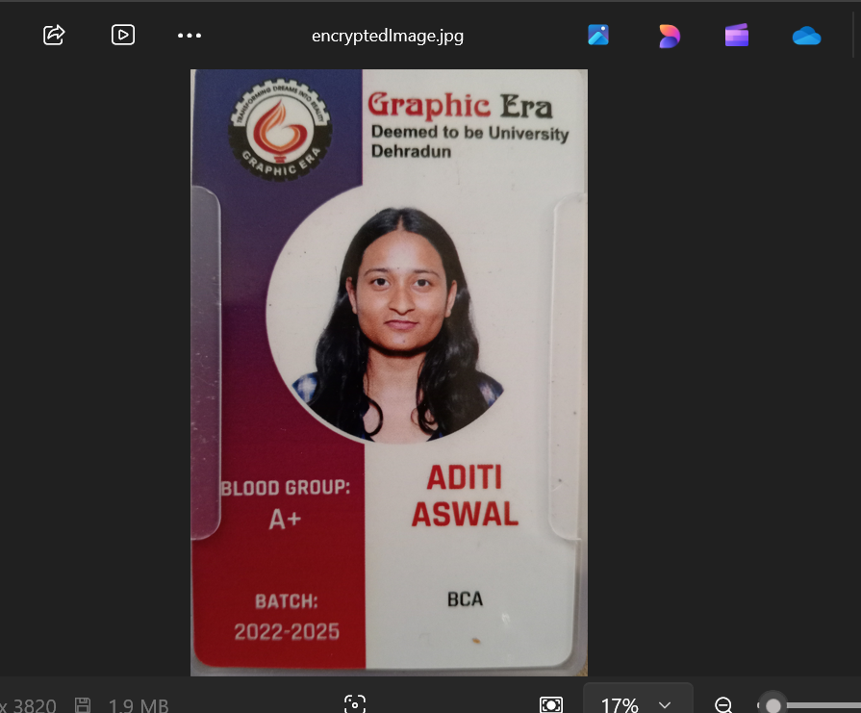
Results
Encryption process
Decryption process to retrieve the hidden message
The code for encrypting the image with secret msg
Encrypted image

Slide 8
Conclusion
This project successfully implements secure data hiding using steganography, allowing users to embed and retrieve secret messages within an image using a password. By leveraging Python, OpenCV, the system ensures efficient and undetectable encryption, making it suitable for confidential communication.
The password-protected mechanism adds an extra layer of security, ensuring that only authorized users can access the hidden data. This approach can be applied in military, intelligence, journalism, and secure data transmission, making it a valuable tool for protecting sensitive information.

Slide 9
GitHub Link
https://github.com/Aditi-Aswal2/stegnography.git

Slide 10
Future scope(optional)
Future enhancements may include support for larger messages, advanced encryption techniques,
and a graphical user interface (GUI) for improved usability.

Slide 11
THANK YOU

